Slide 1
Modes in Optical Fibers
Notes:
SJCET

Slide 2
Topics:-
Basic principle of light propagation
Numerical Aperture & Acceptance angle
Mode Theory
Modes in planar waveguides
Mode Condition
TE and TM modes
Single and Multi-mode Fibers
Multimode Distortion
– SI, GRIN and single mode fibers

Slide 3
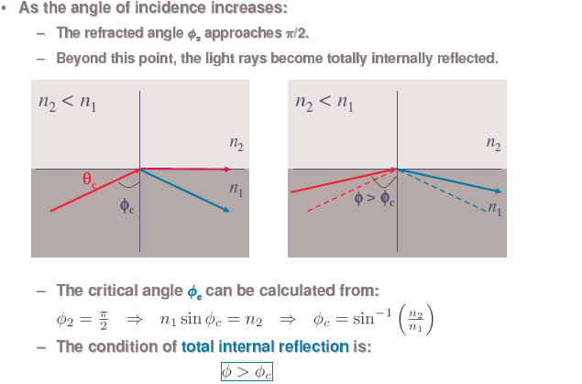
Basic principles light propagation
Notes:
SJCET

Slide 4
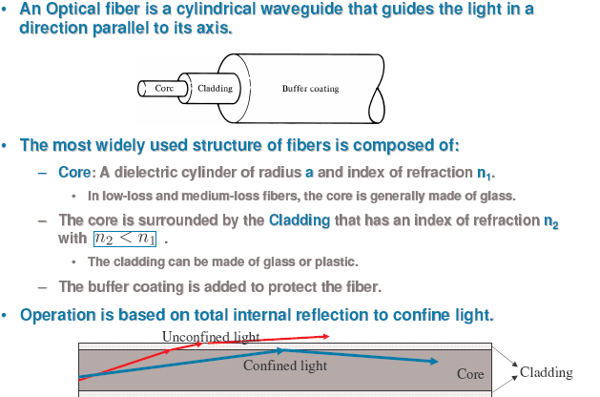

Slide 5
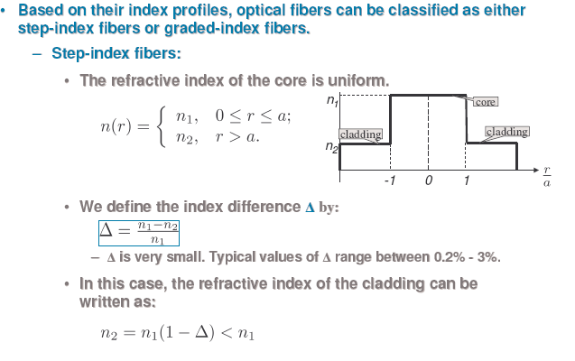
r = light incidence ray position (0 to a)
a = core radius

Slide 6
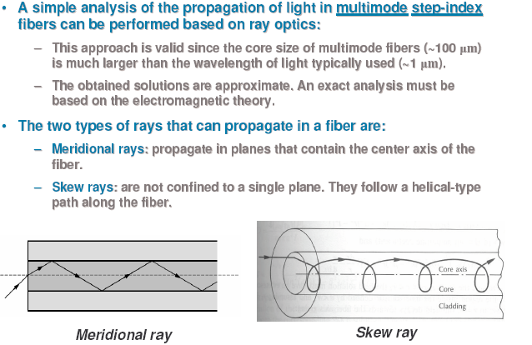
Light wave propagation in optical fiber

Slide 7
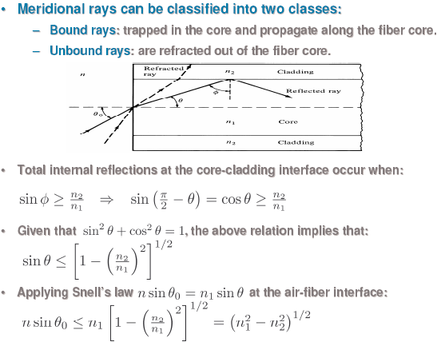

Slide 8
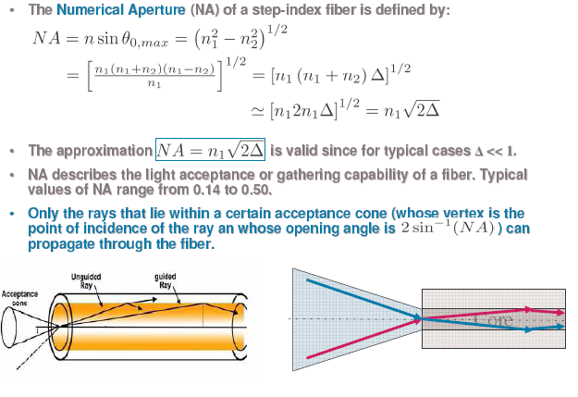
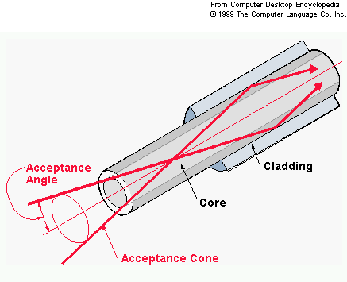
Numerical Aperture

Slide 9
Mode Theory
The mode theory, along with the ray theory, is used to describe the propagation of light along an optical fiber
The mode theory uses electromagnetic wave behavior to describe the propagation of light along a fiber

Slide 10
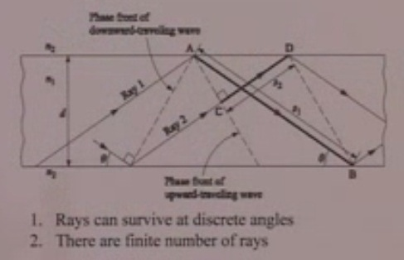
Light Propagation planer wave guide
ᵟ

Slide 11

Then the equation for sustain propagation is depend upon the diameter of core (d)
Wave length (λ)
And angle of propagation sinӨ
Refractive index of core (n₁)
Then the equation represent as

Slide 12
Modes in planar waveguide
The optical wave is effectively confined within the guide and the electric field distribution in the x direction does not change as the wave propagates in z direction.
The stable field distribution in the x direction with only aperiodic z dependence is known as a mode.
A specific mode is obtained only when the angle between the propagation vectors or the rays and the interface has a particular value.
Hence, the light propagating within the guide is formed into discrete modes, each typified by a distinct value of θ.

Slide 13

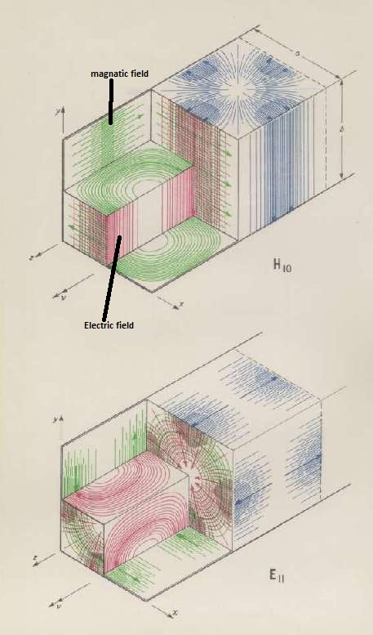

Waveguides or fiber optics obey Maxwell equations, for the light propagation in an isotropic dielectric material with no free charges are:
(Faraday law, Gauss law)
(Ampere law, Gauss law)
Green: magnetic field
Red : electric field

Slide 14



And the relationships between field types (for simple, isotropic dielectric material with no free charges) are:
And corresponding wave equation can be found by using above value and the vector identity method
which is the same for the magnetic field:

Slide 15
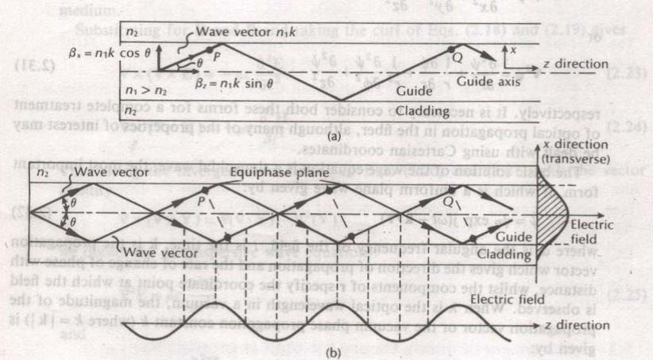
Planer wave guide light propagation

Slide 16
Mode Condition
The component of plane wave in the x-direction is
reflected at the interface between the higher and lower
refractive index media.
The component of wave in x-direction gives constructive
interference to form standing wave patterns across the guide when the following condition is met
ΔΦ = m 2π , where m is an integer
The next slide shows examples of such rays for m=1,2,3
together with the electric field distributions in the x direction

Slide 17
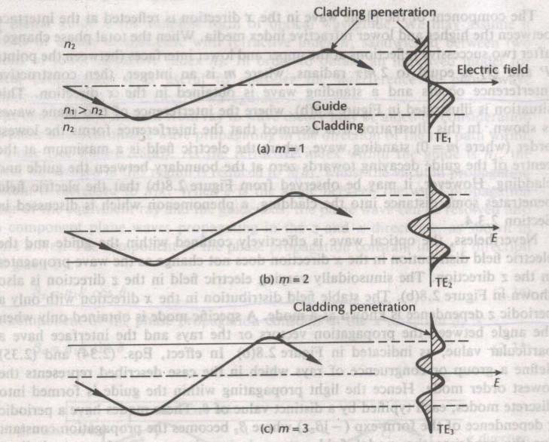
Modes in a Planar Guide

Slide 18
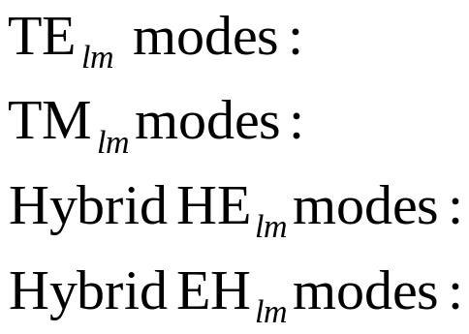


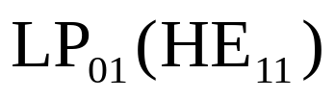
Mode designation in circular cylindrical waveguide (Optical Fiber)
The electric field vector lies in transverse plane.
The magnetic field vector lies in transverse plane.
TE component is larger than TM component.
TM component is larger than TE component.
y
l= # of variation cycles or zeros in direction.
m= # of variation cycles or zeros in r direction.
r
x
z
Linearly Polarized (LP) modes in weakly-guided fibers ( )
Fundamental Mode:

Slide 19
TE and TM Modes
Maxwell's equations describe electromagnetic waves or modes as having two components.
The two components are the electric field, E(x, y, z), and the
magnetic field, H(x, y, z). The electric field, E, and the magnetic
field, H, are at right angles to each other.
Modes traveling in an optical fiber are said to be transverse. The transverse modes propagate along the axis of the fiber.
In TE modes, the electric field is perpendicular to the direction of propagation.
In TM modes, the magnetic field is perpendicular to the direction of propagation. The electric field is in the direction of propagation

Slide 20
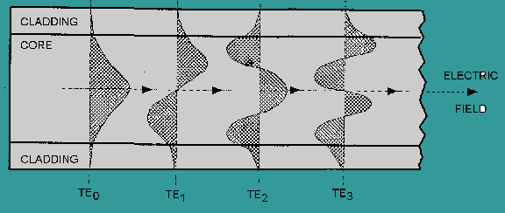
TE Modes

Slide 21
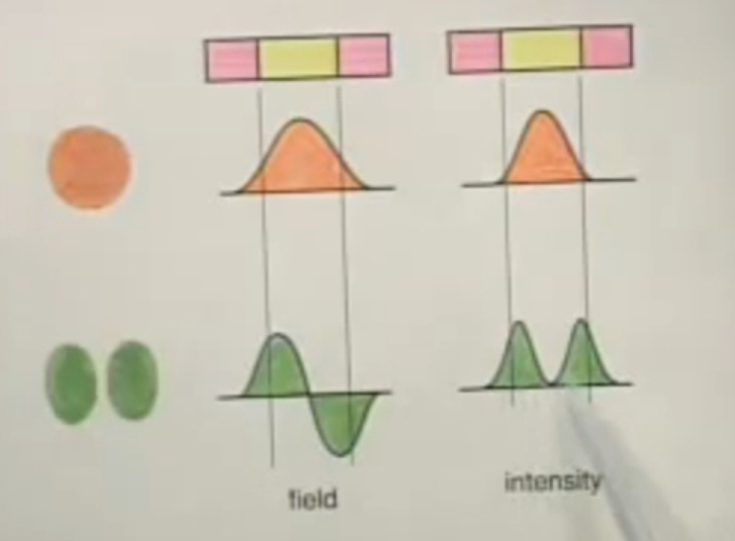

Slide 22
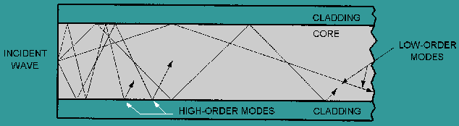
High and Low order Modes

Slide 23
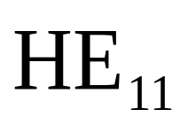
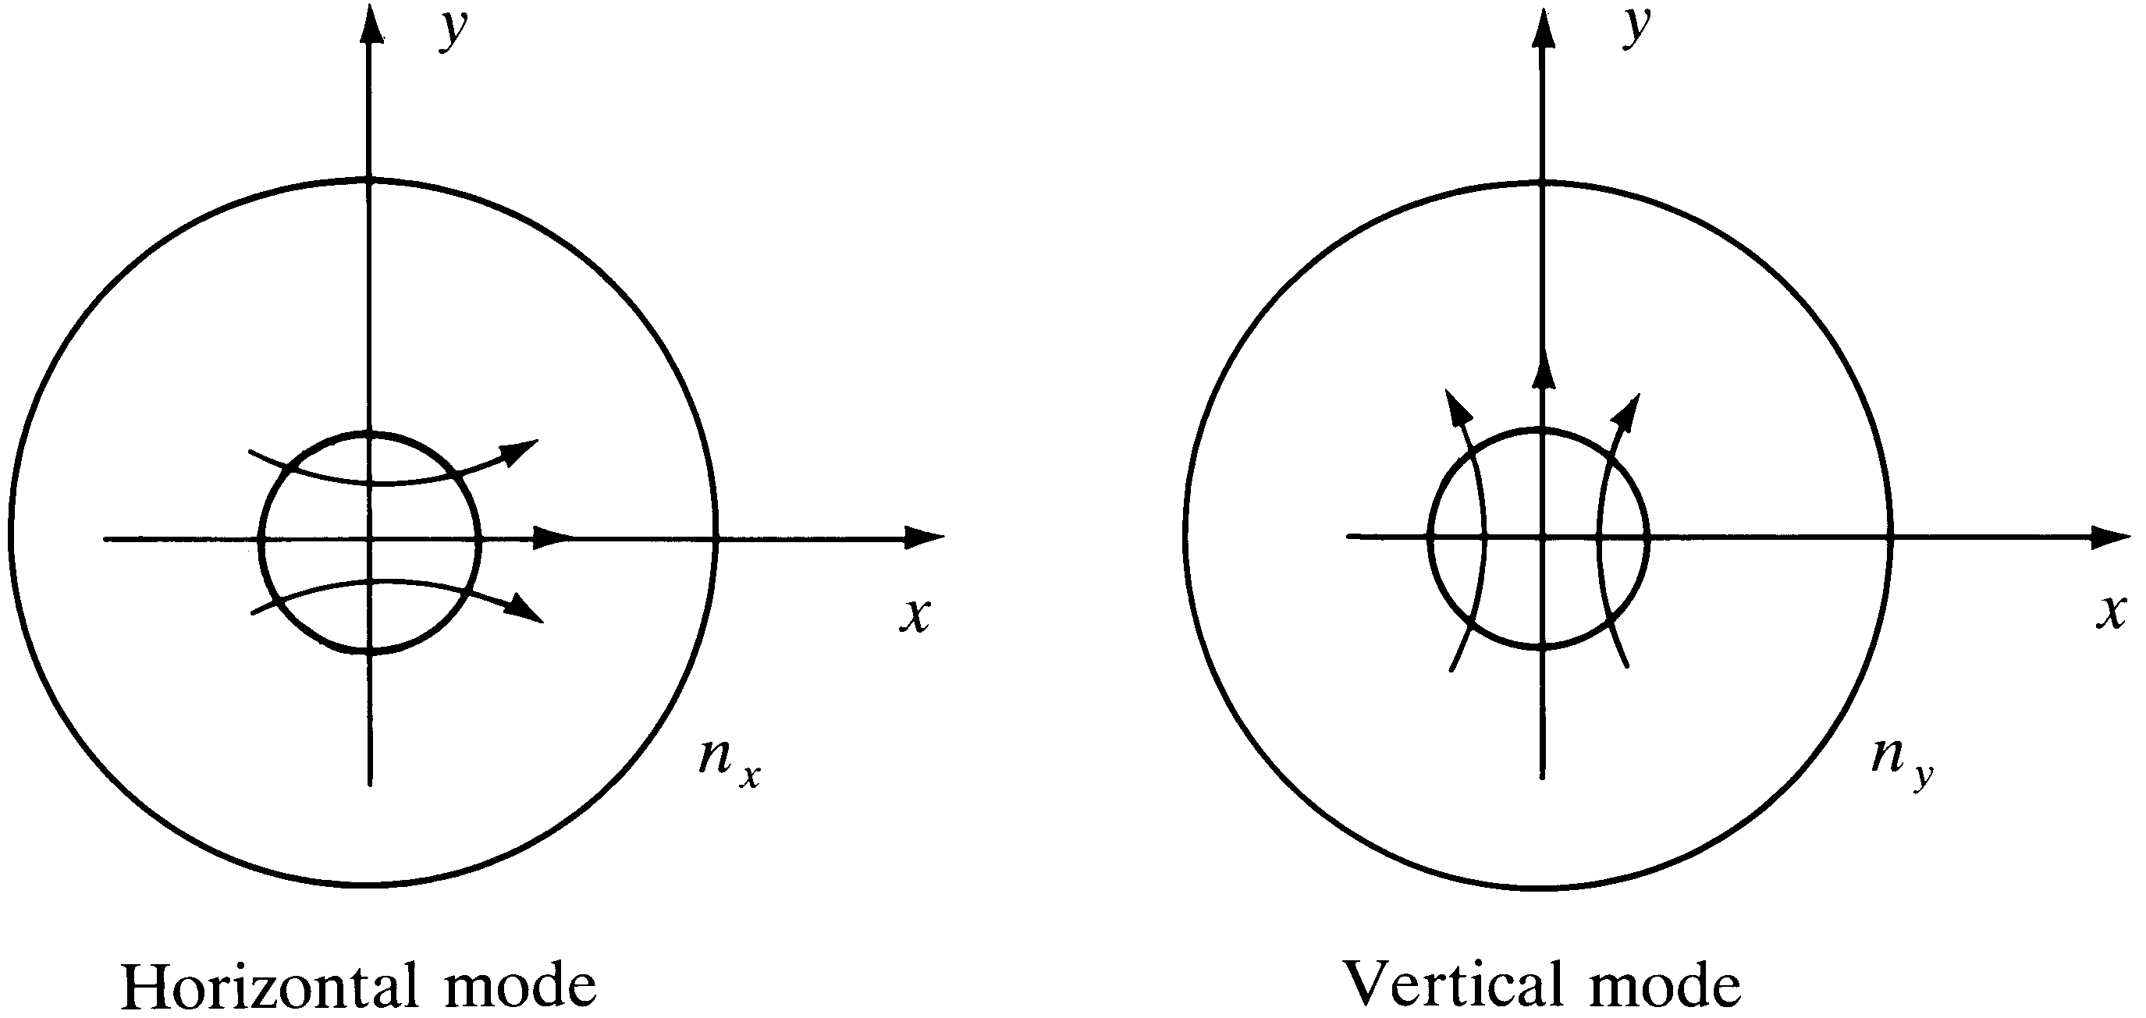
Two degenerate fundamental modes in Fibers (Horizontal & Vertical Modes)

Slide 24
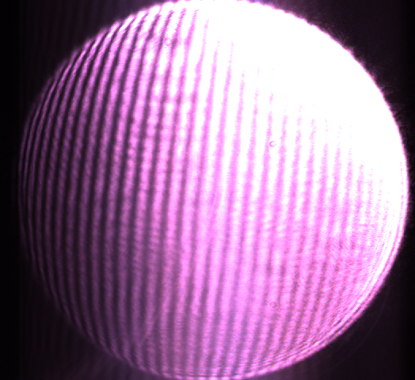
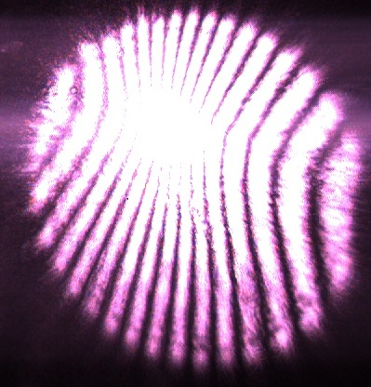
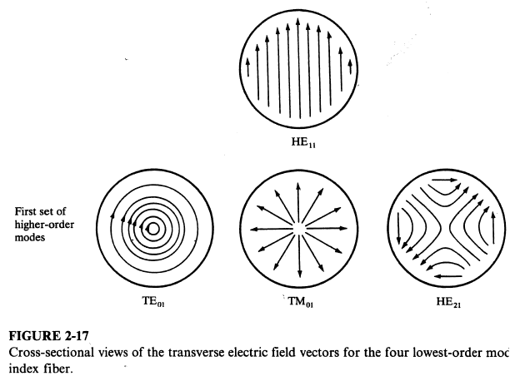
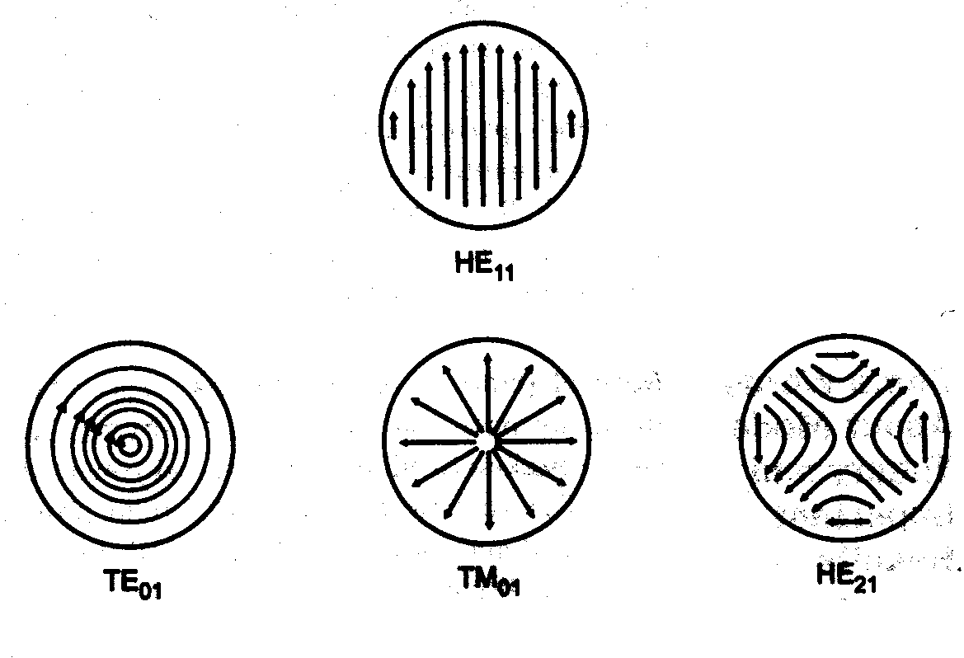
End view, cylindrical modes
Notes:
SJCET

Slide 25
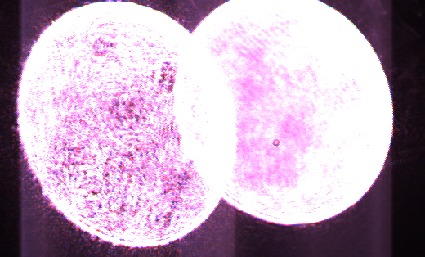
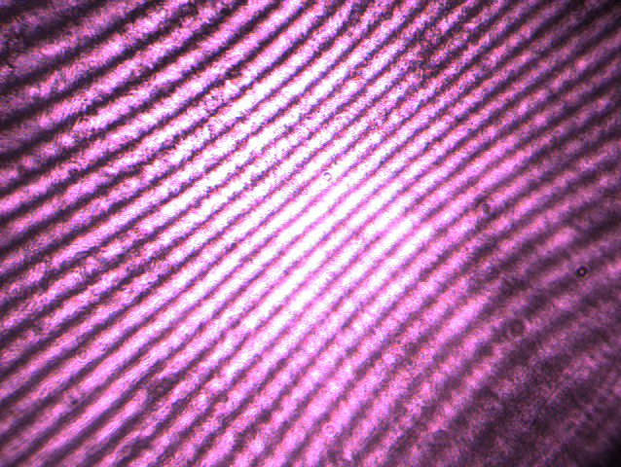
Practical end view of different fringes pattern in different hybrid mode from 830nm LASER source
Multimode o/p
HE pattern showing interference

Slide 26
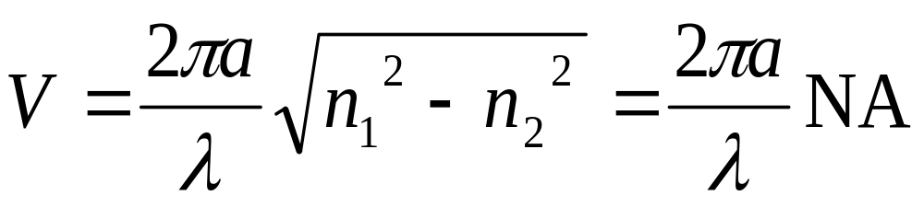

Mode propagation constant as a function of frequency
In order to find a mode propagation constant and cut-off frequencies of various modes of the optical fiber, V- number is most importance. And it can be given as:
An index value V, defined as the normalized frequency is used to determines how many different guided modes a fiber can support.
a: radius of the core, λ is the optical free space wavelength,
are the refractive indices of the core & cladding.
Notes:
SJCET

Slide 27
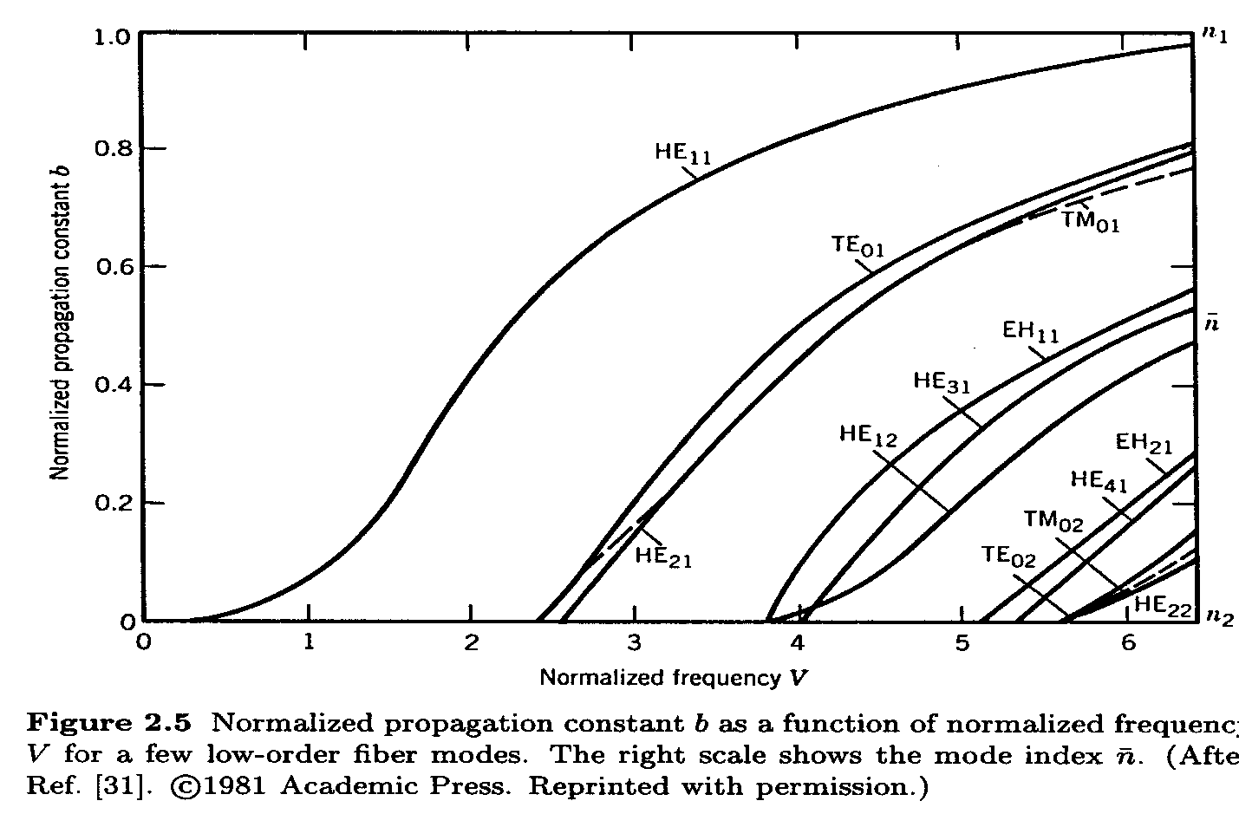
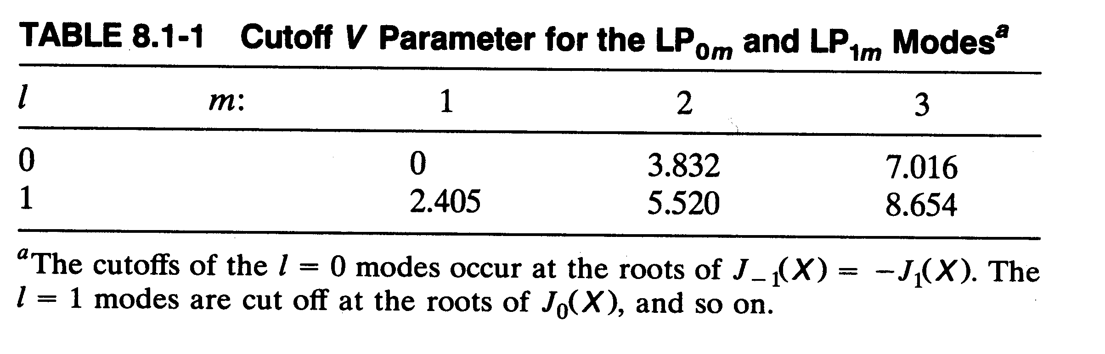
Mode of fiber based on V-number and propagation constant:-
Each mode has a specific
  Propagation constant β (=βz)
  Spatial field distribution
  Polarization

Slide 28
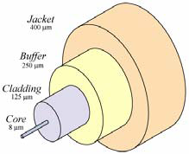
Single Mode Fibers
Fiber supporting only one mode is called single-mode or
mono-mode fiber.
Single-mode fiber allows for a higher capacity to transmit information because it can retain the fidelity of each light pulse over longer distances, and it exhibits no dispersion
caused by multiple modes
The most common type of single-mode fiber has a core
diameter of 4 to 10 μm. The smaller core diameter
makes coupling light into the core more difficult.
Data rates of up to 10 gigabits per second are possible
at distances of over 60 km with commercially available
transceivers.

Slide 29
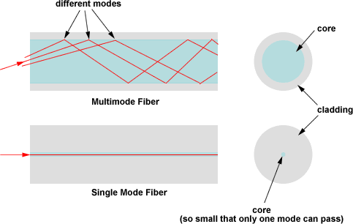
Single Mode vs Multimode

Slide 30
In multimode fibers the differences in the propagation delays of various modes leads to signal dispersion in an optical-fiber link.
This intermodal delay or modal dispersion effect limits the speed at which information can be transmitted over a fiber.
SMF is used to minimize the Intermodal signal dispersion and fundamental mode is allowed to propagate.
Single Mode Fiber

Slide 31
Construction
Single-mode fibers are constructed by letting the dimensions of the core diameter be a few wavelengths (8 -12) and by having small index differences between the core and the cladding.
In practical designs of single- fibers, the core cladding index difference varies between 0.2 and 1.0 percent, and the core diameter be chosen to be just below the cutoff of the first higher order mode, that is, for V slightly thun 2.4.

Slide 32
Mode Field Diameter
MFD can be determined from the mode field distribution of the fundamental fiber mode and is a function of the optical source wavelength, the core radius, and the refractive index profile of the fiber.
The MFD is an important parameter for single-mode fiber because it is used to predict fiber properties such as splice loss, bending loss, cutoff wavelength and waveguide dispersion.
If V =2 only 75 present optical power is confined to the core.

Slide 33
MFD..
A standard technique to find the MFD is to measure the far-field intensity distribution E (r) and then calculate the MFD using the Petermann II equation.

Slide 34
Graded Index Fiber Structure

Slide 36
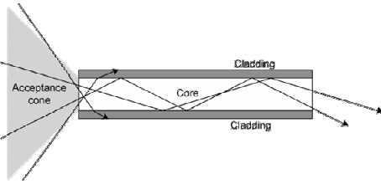
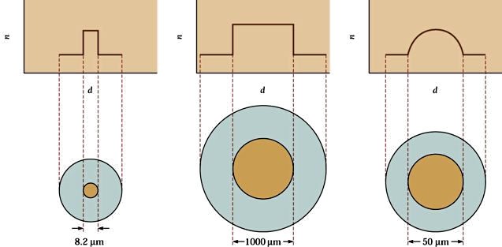
Multi-mode Fiber
Multimode fiber is best designed for short transmission distances,
and is suited for use in LAN systems and video surveillance
Modes result from the fact that light will only propagate in the fibercore at discrete angles within the cone of acceptance.
Multi-mode fibers have large core diameters and they can support applications from 10 Mbit/s to 10 Gbit/s over link lengths of up to 550meters, more than sufficient for the majority of premises applications.

Slide 37

Light propagation in a multimode Fiber
Notes:
SJCET

Slide 38
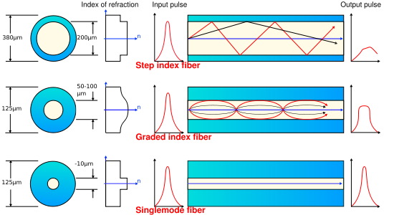
Modal Dispersion

Slide 39
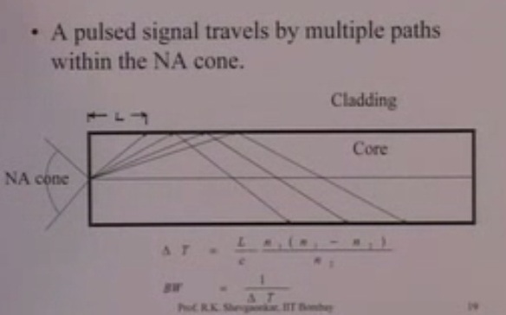
Distortion in MI Fibers

Slide 40

Distortion in Step Index Fibers
Reduction in pulse spreading
– Mode mixing
Due to bends and scattering
– Attenuation of higher ordered modes
Total pulse spreading
Which of the material dispersion or multimode spreading is greater?
– We can reduce material and waveguide dispersion using a source with smaller line width like laser but since modal distortion is much greater, it is in effective and it will be cheaper to use an LED

Slide 41
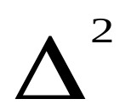
Distortion in Graded-Index Fibers
Much Less multi-mode distortion. Why?
Typical pulse spread is just a few nano sec per km
Modal Spread in GRIN Fiber
Δτ/L = n1 /2c
Pulse spread decreases by a factor of 2/Δ by using
GRIN instead of SI
What is the pulse spread for GRIN fiber with n1 = 1.48 and n₂ = 1.46?

Slide 42
Distortion in Single Mode Fibers
Only material and waveguide dispersion
Pulse Spread is smaller for longer wavelengths and narrower line widths. Why?
Which source is preferable in this case??
Can the sum of material and wave guide
dispersion become zero?

